Slide 1

Healthcare Project
By: Abhishek,Khushvir
Tania,Priti,
Manpreet,Gurpreet
College Name
Roll No
Stream

Slide 2

Company
Profile
Certification: ISO 9001:2015 Certified
Specializations:
- Web Development
- Mobile Application Development
- Custom Software Development
- UI/UX Design
- Hosting Services
- Digital Marketing
Services:
- Advanced IT solutions supporting the entire business
- Consulting to system development
- Deployment
- Quality Assurance
- 24x7 Support
Headquarters: Jalandhar
Branch Office: Hoshiarpur

Slide 3

Table of Content
Project Explanation
Main Objectives
Cause of Deaths
Preventions
Advantages of Healthcare
Future scope
Technology Used
Conclusion
Thankyou

Slide 4

Project Explanation
Here we will discuss about health diseases and other causes of deaths and we will figure out how to focus on prevention.

Slide 5

Main Objectives
Improve patient outcomes
Increase accessibility
Health Promotion and Disease Prevention
Support healthcare

Slide 6
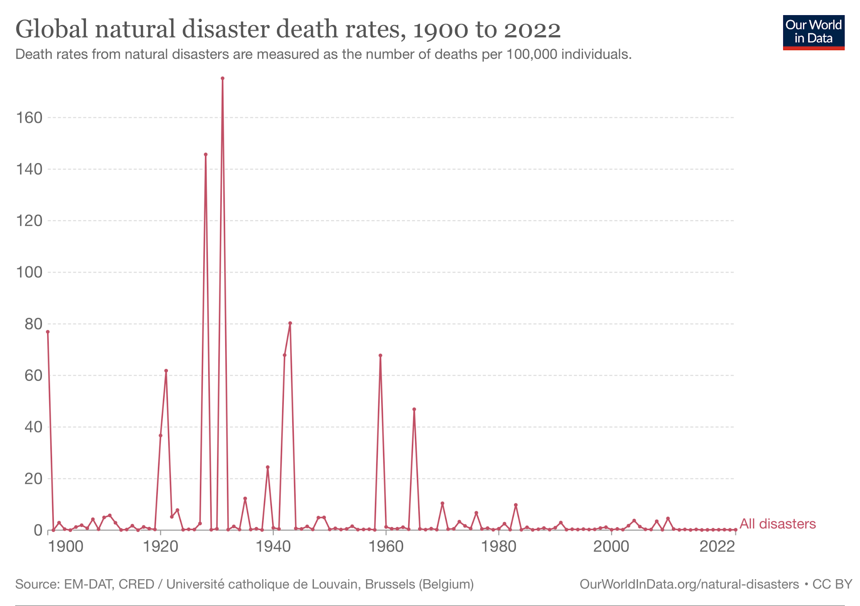
Cause of Deaths
By different kind of diseases
that are spreaded worldwide
Most deadly diseases are Cardiovascular,respiratory,infectious(tb,vector borne),cancer,diabeties

Slide 7
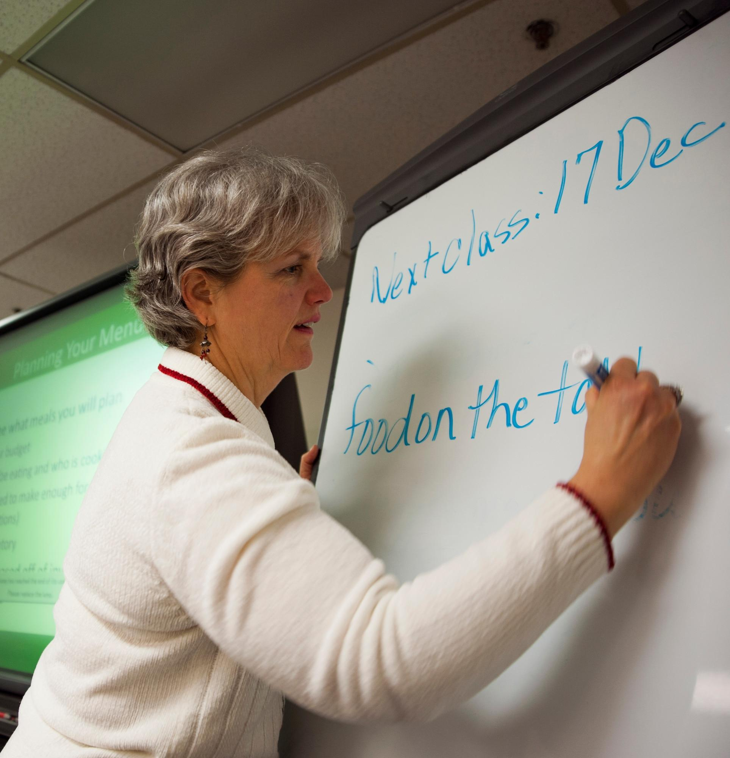



Preventions
Vaccination Programs
Health Education
Environmental Factors
Public Health Policies

Slide 8
Advantages of Healthcare
Enhanced Quality of Life
increased life expectancy
Personal Empowerment
Improved Health Outcomes

Slide 9

Future Scope
The future scope of healthcare projects is vast and promising due to ongoing advancements in technology, increased focus on patient-centered care, and evolving healthcare needs worldwide.

Slide 10

Technology used

Slide 11
Technology
PANDAS
MY SQL
STREAMLIT
PYTHON

Slide 12

CONCLUSION
Impact on Patient Care
Technological Advancements
Improved disease prediction and Diagnosis
Acknowledgments: Acknowledge the contributions of team members who supported the project.

Slide 13
THANKS!
Any questions?

Slide 14
SCREENSHOTS

Slide 15
Data Flow Diagram

Slide 16

User Functionality
Register
Login
View Products

Slide 17
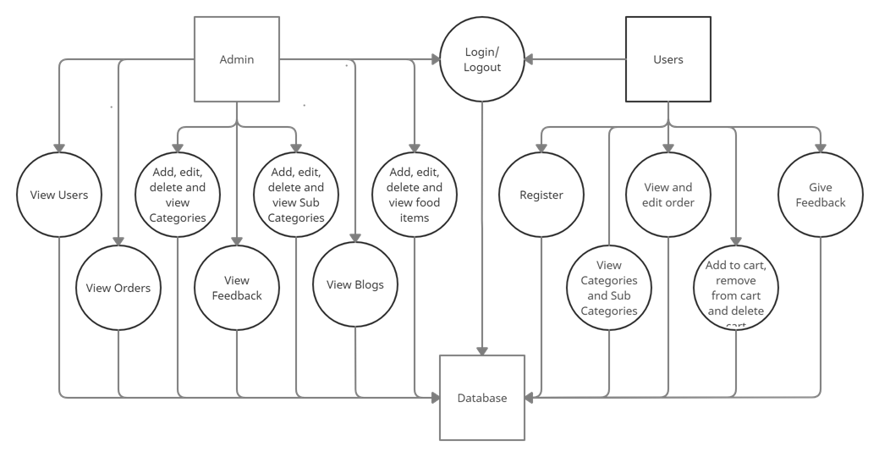
DFD Diagram of Project

